Slide 1
Physical Science STEM Lessons
Cobb STEM Innovation Academy
March 9, 2017

Slide 2
Linda Wade
Lovinggood Middle School
8th Grade AC Physical Science
linda.trawick@cobbk12.org
Matter Mystery
Paper Roller Coasters
Thermos Challenge
Electric House
Silver City Tram Challenge

Slide 3
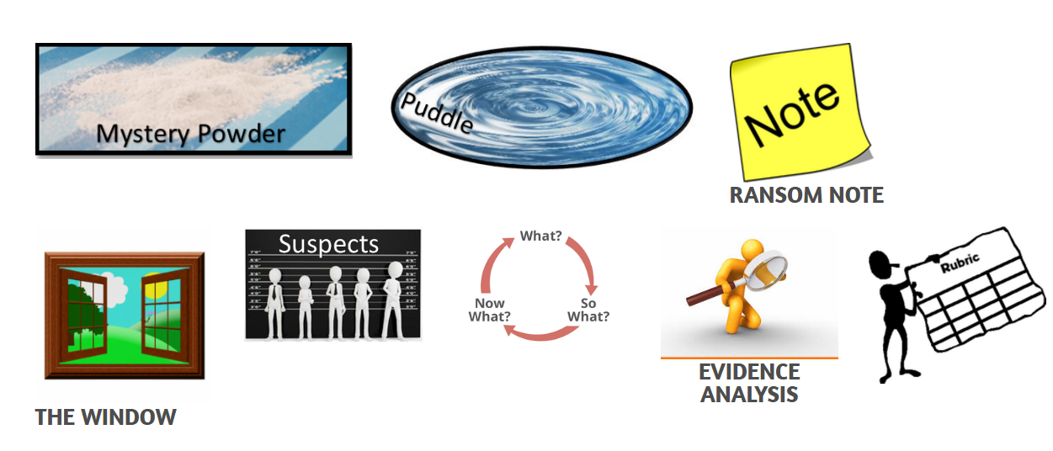
Matter Mystery
8th Grade Physical Science Standard
S8P1. Students will examine the scientific view of the nature of matter.
Math Concepts
Converting measurements
Pythagorean Theorem
Calculating circumference
ISTE Student Standard
Creative Communicator Students communicate clearly and express themselves creatively for a variety of purposes using the platforms, tools, styles, formats and digital media appropriate to their goals.
Who Took Rover?

Slide 4
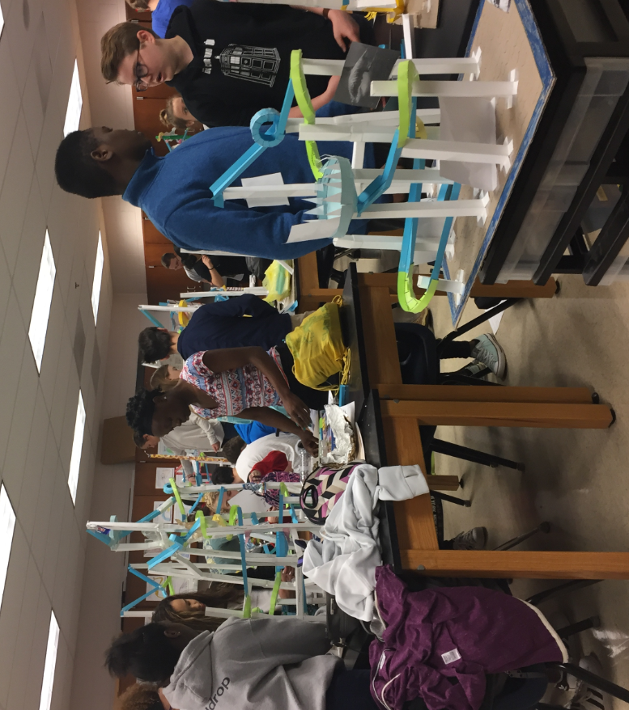
Paper Roller Coasters
8th Grade Physical Science Standards
S8P3. Students will investigate relationship between force, mass, and the motion of objects
S8P2. Students will be familiar with the forms and transformations of energy.
Math Concepts
Solving equations
measurement
Engineering Practices
Asking Questions and Defining Problems
Constructing Explanations and Designing Solutions
3917

Slide 5
Thermos Challenge
8th Grade Physical Science Standard
S8P2. Students will be familiar with the forms and transformations of energy.
a. Explain energy transformation in terms of the Law of Conservation of Energy.
d. Describe how heat can be transferred through matter by the collisions of atoms (conduction) or through space (radiation). In a liquid or gas, currents will facilitate the transfer of heat (convection).
Math Concepts
Solving equations
Measurement
Graphing
Engineering Practices
Asking Questions and Defining Problems
Constructing Explanations and Designing Solutions
Engaging in Argument from Evidence
3917
Adapted from:
https://www.teachengineering.org/activities/view/wsu_heat_activity
Also found:
http://mariana68.wixsite.com/thermos-challenge

Slide 6
Electric House
8th Grade Physical Science Standard
S8P5. Students will recognize characteristics of gravity, electricity, and magnetism as major kinds of forces acting in nature.
b. Demonstrate the advantages and disadvantages of series and parallel circuits and how they transfer energy.
c. Investigate and explain that electric currents and magnets can exert force on each other.
Engineering Practices
Asking Questions and Defining Problems
Constructing Explanations and Designing Solutions
Engaging in Argument from Evidence
Modified from: http://pleasanton.k12.ca.us/avhsweb/barnettDreyfuss/Physics/Documents/Electric%20House%20Project%2011.pdf
3917

Slide 7
Tram Challenge
Next Generation Science Standard
`HS-ESS3-2.Evaluate competing design solutions for developing, managing, and utilizing energy and mineral resources based on cost-benefit ratios.
ISTE Student Standard
Creative Communicator Students communicate clearly and express themselves creatively for a variety of purposes using the platforms, tools, styles, formats and digital media appropriate to their goals.
Math Concepts
Solving equations
Measurement
Graphing
Engineering Practices
Asking Questions and Defining Problems
Constructing Explanations and Designing Solutions
Engaging in Argument from Evidence

Slide 8
Everything presented today can be accessed at:
3917.weebly.com
Linda Wade
Lovinggood Middle School
linda.trawick@cobbk12.org

Slide 9
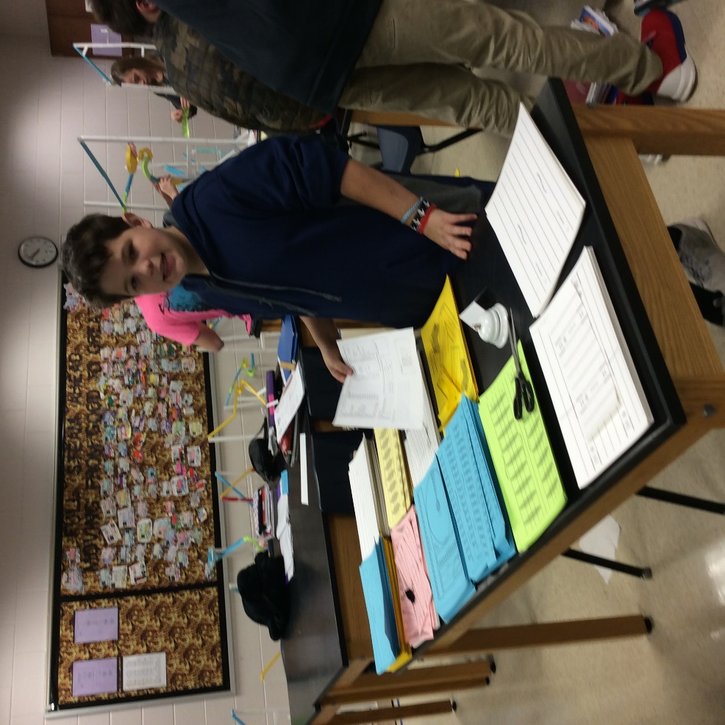
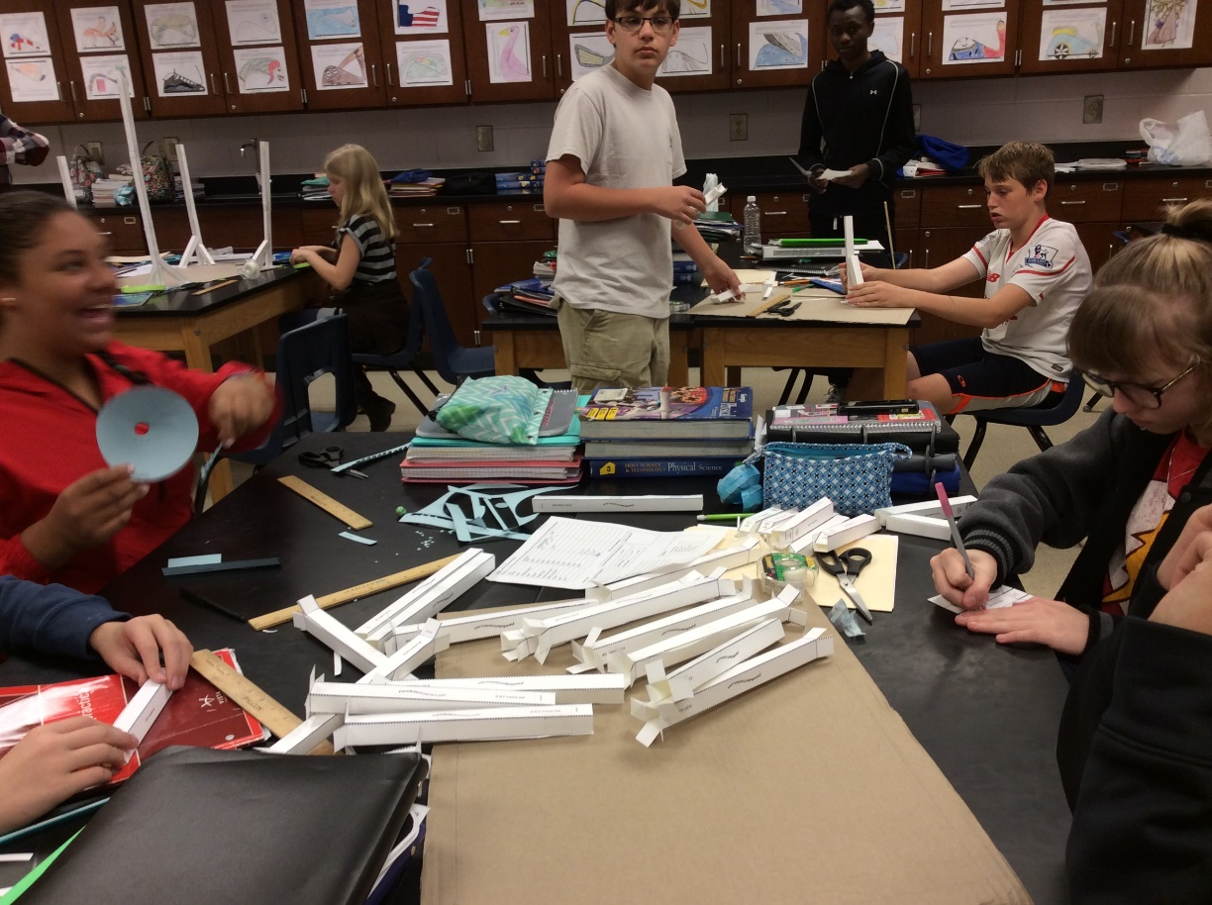

Slide 10
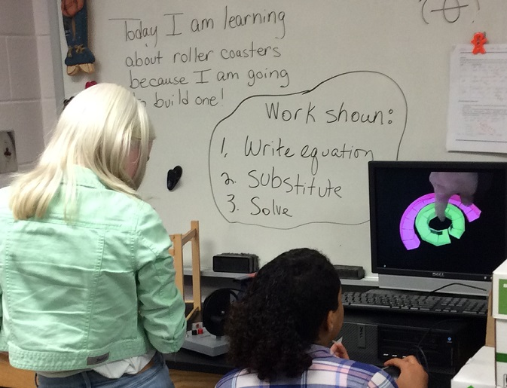
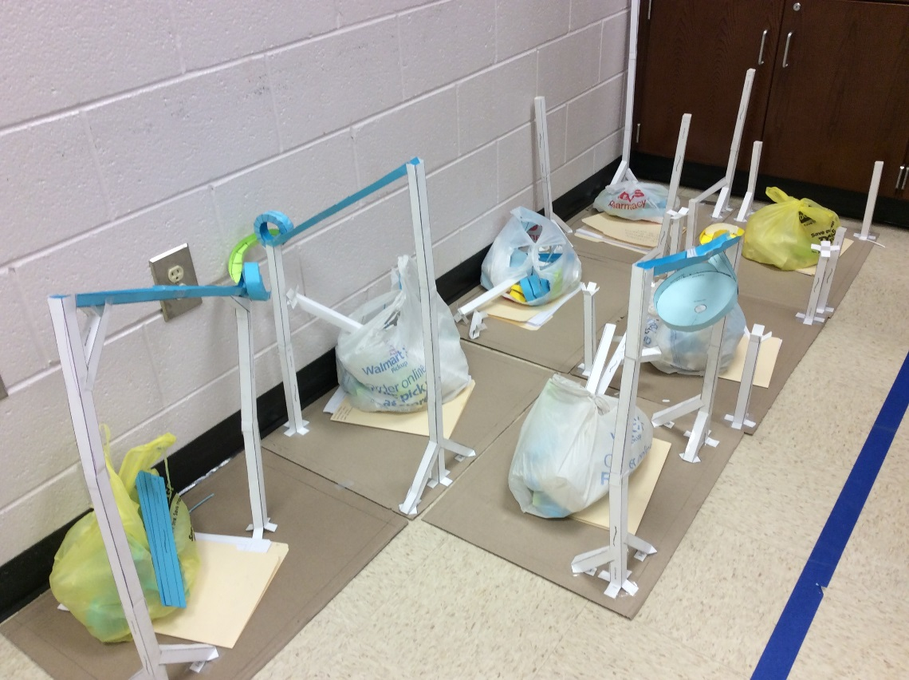

Slide 11
